Slide 1
General characteristics of the Mosses, Lycopodium, Horsetails
Laboratory work 2.1.

Slide 2
Material:
Division Hepaticophyta – Liverworts
Class Hepaticopsida
Order Marchantiales
Family Marchantiaceae
Genus Marchantia, Species M. polymorpha
Objects:
Herbarium of Marchantia polymorpha
Permanent preparations of antheridium and archegonia.
Objective:
To familiarize with the structural features of Marchantia polymorpha
Tasks of work:
Recognize and draw an appearance of a thallus, antheridium and archegonia.
Denote dichotomous branching of a thallus, gemma cups.
Recognize and draw Liverwort Life Cycle, cross section of gemma cup, antheridium and archegonia.

Slide 3
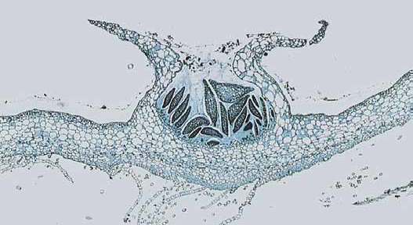
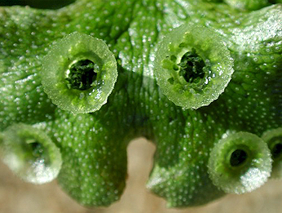
Gemmae
Longitudinal section of a gemma cup.
The gemmae are the dark structures, which in sectional view appear more or less lens-shaped.
Gemma cup of Marchantia

Slide 4
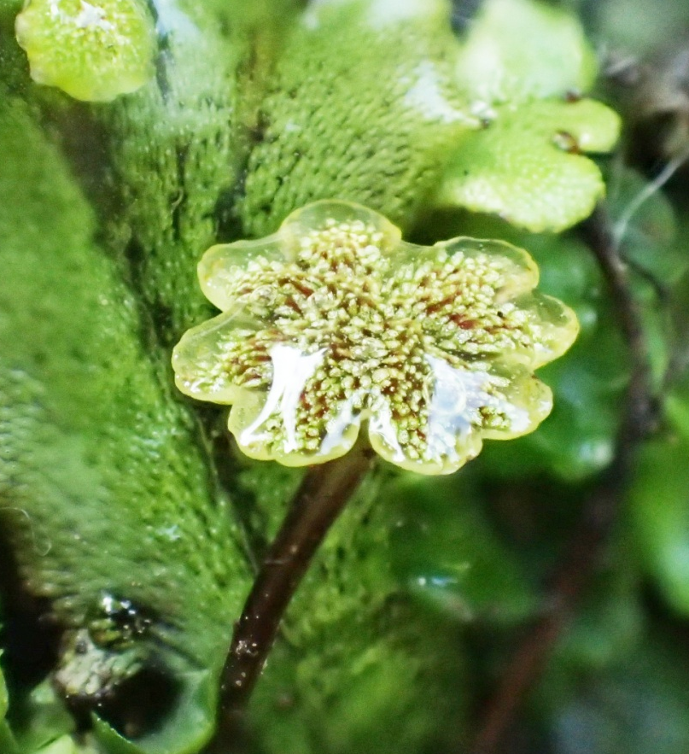
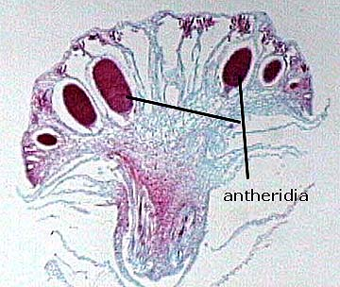
Antheridium of Marchantia

Slide 5
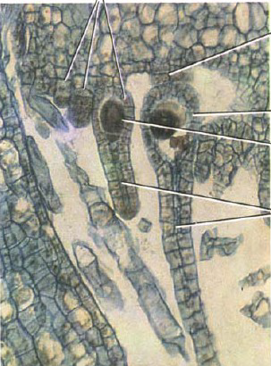
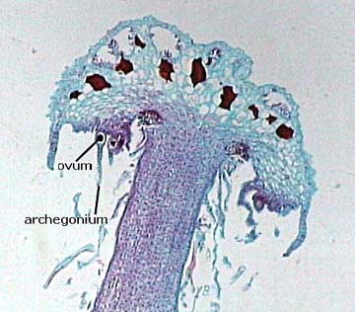
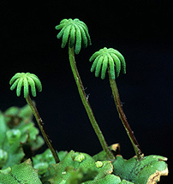
Archegonia
venter
egg
neck canal cell
Archegoniophore of Marchantia.

Slide 6
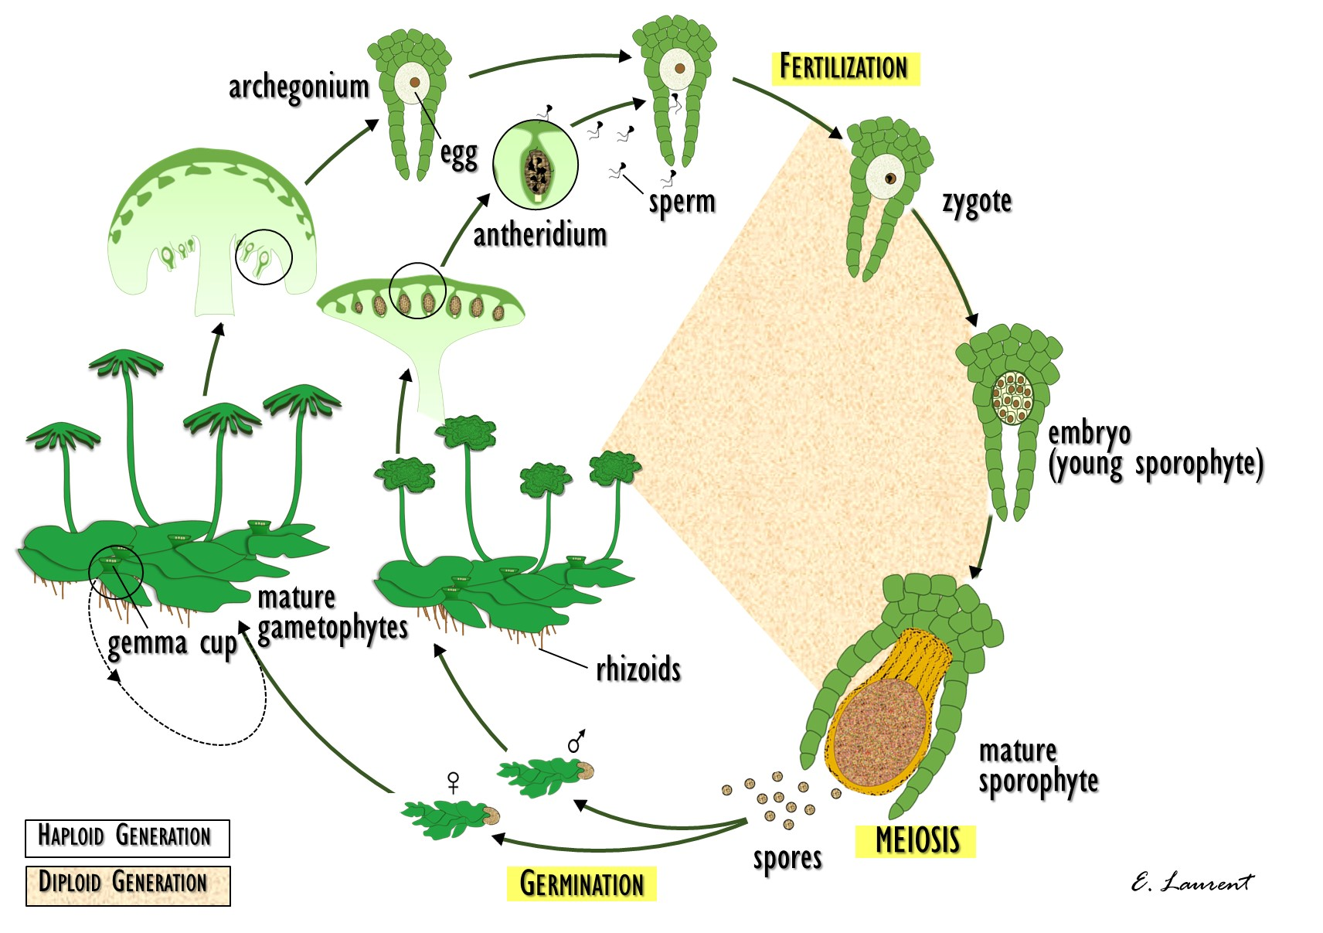
Liverwort life cycle

Slide 7
Material:
Phylum- Bryophyta (Mosses)
Class- Bryopsida = Musci (True Mosses)
Order- Polytrichales
Family- Polytrichaceae
Genus- Polytrichum (Hair-cap Mosses), Species – P. commune
Objects:
Herbarium and permanent preparation of Polytrichum commune
Objective:
To investigate the structural features of Polytrichum commune
Tasks of work:
Draw the appearance of the shoots of Polytrichum commune.
Draw and denote a moss sporophyte, showing the seta (stalk), capsule (sporangium), operculum (cap), peristome teeth, and spores.
Draw Life Cycle of Polytrichum commune

Slide 8
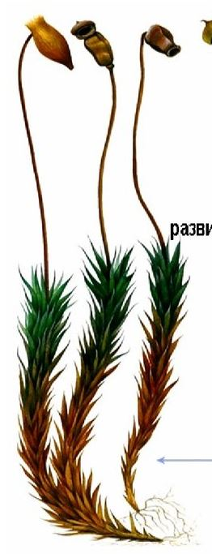
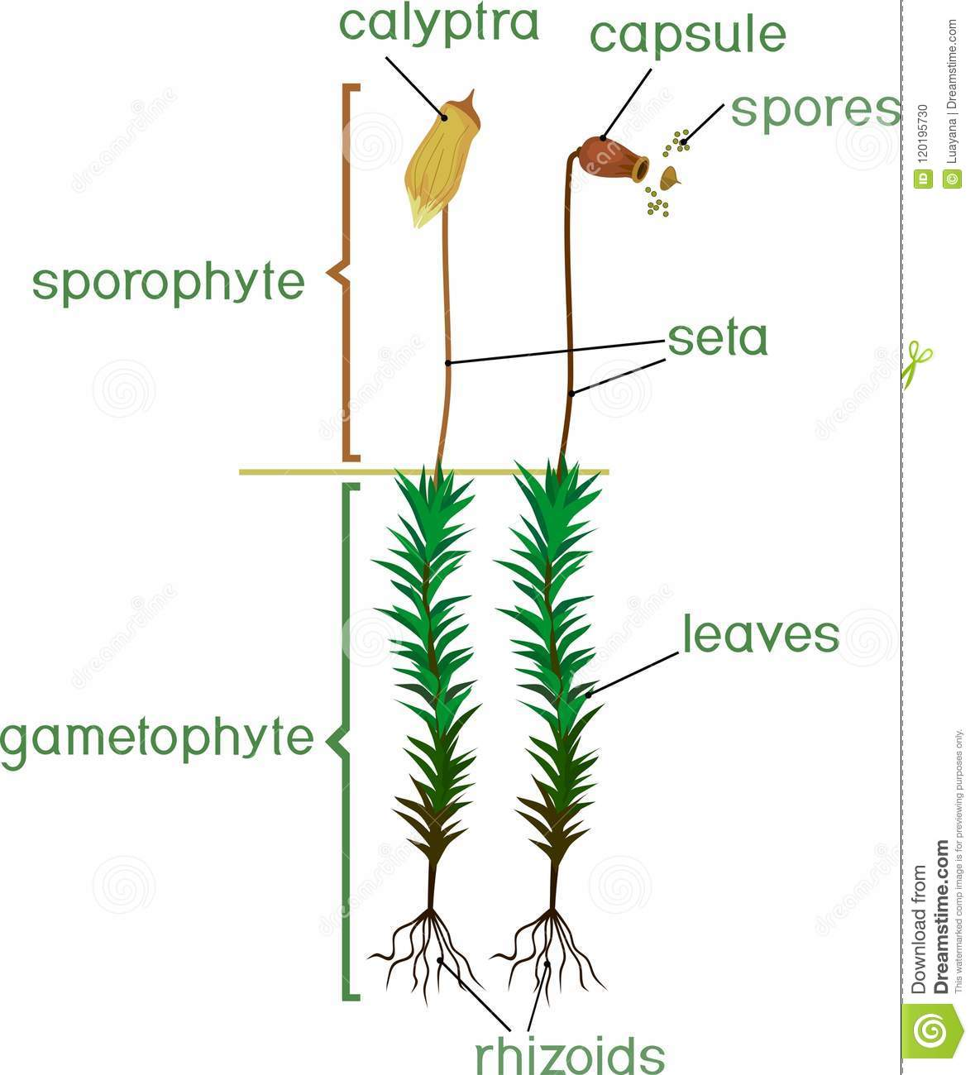
capsule
calyptra
seta
leaves
rhizoids
Polytrichum commune

Slide 9
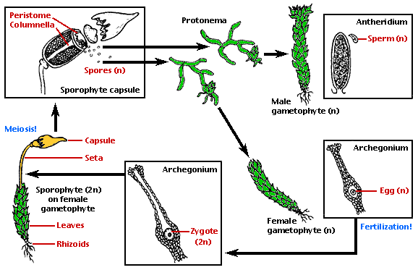
Life cycle of Polytrichum commune

Slide 10
Material:
Division Lycopodiophyta – Lycopods
Class Lycopodiopsida
Order Lycopodiales
Family Lycopodiaceae – Club-moss family
Genus Lycopodium – clubmoss
Objects:
Herbarium of Lycopodium sp.
Permanent longitudinal section preparation of Lycopodium sp. strobilus.
Objective:
To investigate the structural features of Lycopodium sp.
Tasks of work:
Draw and denote a Lycopodium shoot, showing the strobilus. Make an outline drawing of a strobilus longitudinal section, showing the sporophylls and sporangia.
Draw life cycle of Lycopodium.

Slide 11
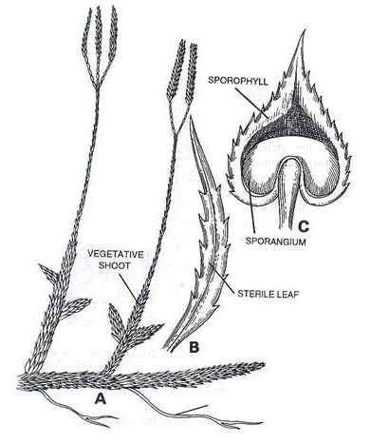
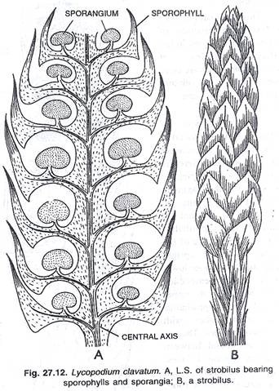
Lycopodium sp., A - strobilus bearing sporophylls
and sporangia, B - strobilus
Lycopodium sp., A - shoot bearing strobili, B – sterile leaf, C – sporophyll with sporangium

Slide 12
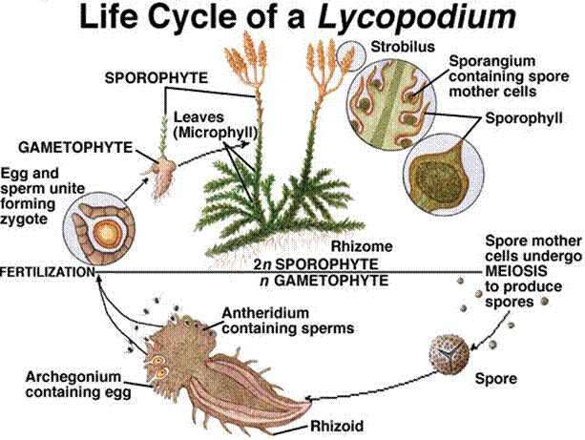

Slide 13
Material:
Division Lycopodiophyta – Lycopods
Class Lycopodiopsida
Order Selaginellales
Family Selaginellaceae - Spike-moss family
Genus Selaginalla – spikemoss
Objects:
Herbarium of Selaginella sp.
Objective:
To investigate the structural features of Selaginella sp.
Tasks of work:
Draw and denote a Selaginella sporangia. Observe the longitudinal-section of Selaginella, showing microsporangia, with microspores, and megasporangia, with megaspores.
Note the vast difference in spore size.
Draw life cycle of a Selaginella.

Slide 14
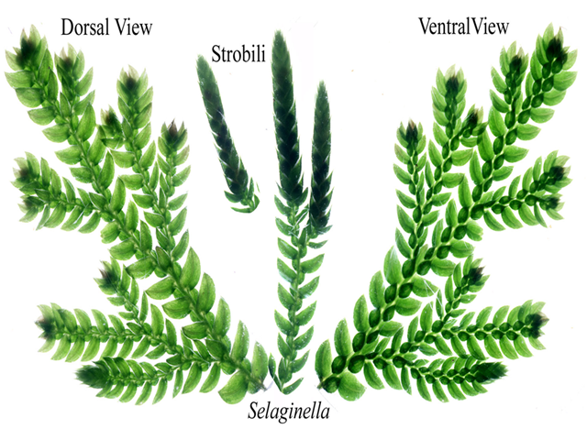
Selaginella: plant body, strobilus

Slide 15
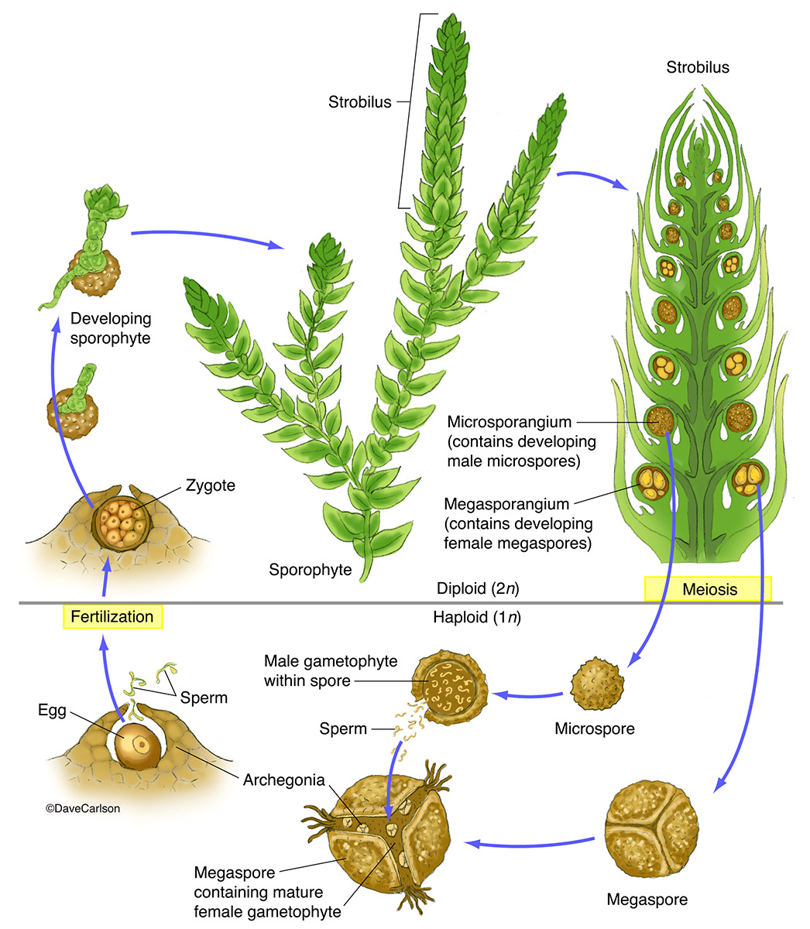
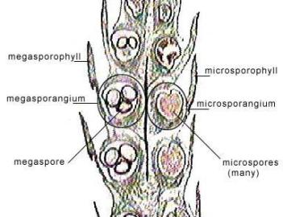
Strobilus of Selaginella sp.
Life cycle of Selaginella

Slide 16
Material:
Division Equisetophyta – Horsetails
Class Equisetopsida
Order Equisetales
Family Equisetaceae – Horsetail family
Genus Equisetum – horsetail
Objects:
Herbarium of Equisetum sp.
Permanent preparation of Equisetum strobilus.
Objective:
To investigate the structural features of Equisetum sp.
Tasks of work:
Draw and label a close-up of the ridged stem, whorled leaves, and (if present) lateral branches
Observe the strobilus (cone) of Equisetum. Observe a sporganiophore with sporangia.
Make a wet mount of the spores and view with the compound microscope. Draw and label the strobilus, sporangiophore, and spore.
Draw life cycle of Equisetum.

Slide 17
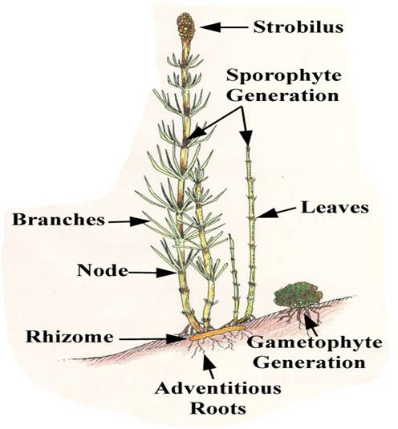
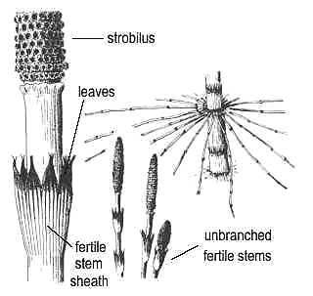
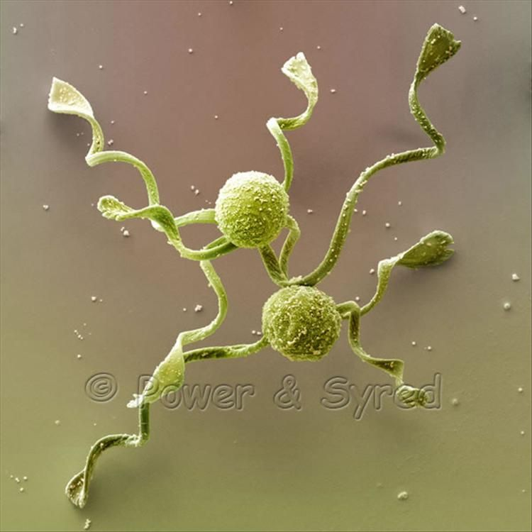
Equisetum plantbody
Equisetum: spores

Slide 18
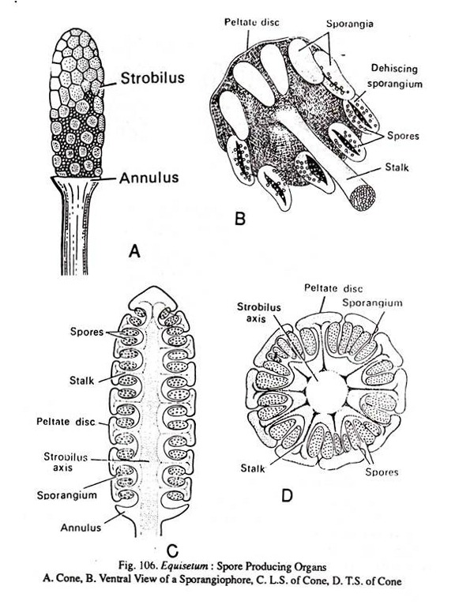
Equisetum: A –cone, B – ventral view of sporganiophore , C - longitudinal-section of cone, D – cross-section

Slide 19
